Slide 1
Innovation Spaces
&
Design Process
https://goo.gl/KbTGhd

Slide 2
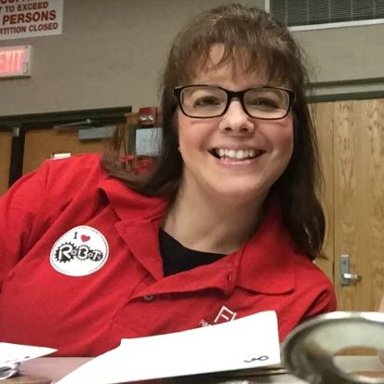
Hello!
I am Renee Lawrence
I’m here to talk about the Innovative Spaces & the Design Process
You can reach me at:
rlawrence@cayboces.org
315.255.7685

Slide 3
The Innovation Space
Other Terms:
MakerSpace
Creative Space
FabLab
DIY Spaces (Do it Yourself)
Hackerspace
Collaborative Work Space
Renovated Learning Spaces
Co-working Spaces
More info on creative spaces
http://renovatedlearning.com/makerspace-resources/
http://www.makerspaceforeducation.com/design-thinking.html

Slide 4
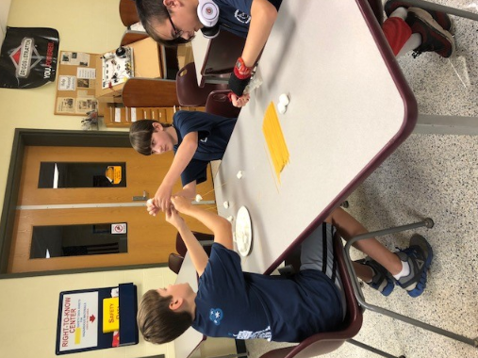
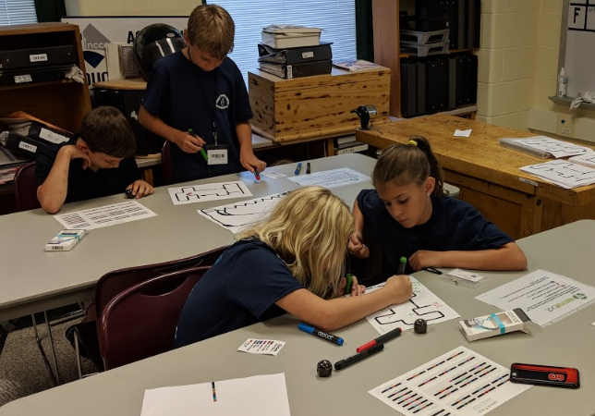
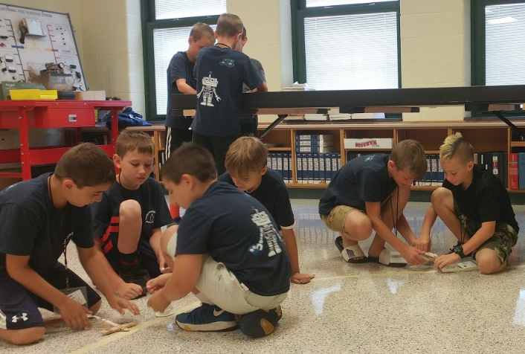
What is an Innovation Space?
A collaborative work space used for making, learning, exploring and sharing. Makers utilize high tech tools such as 3D Printers and advanced cutting machines to no tech tools such as yarn and cardboard.
Robotics Camp
Drones
Makerspace
Lego Robotics
3D Printing

Slide 5
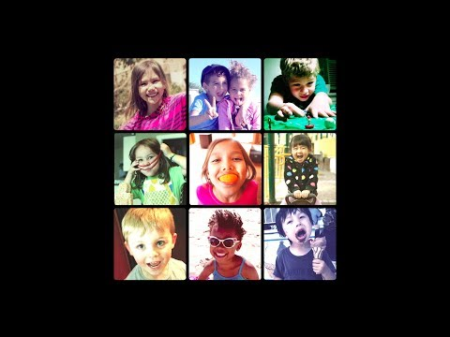

Slide 6
Why is Maker Education so Important?
Helps prepare youth for a future we can’t yet imagine
Creates opportunities that student may never encounter otherwise
Facilitates activities that inspire confidence and help them acquire applicable skills
Helps students move beyond consumption of technology to creation with technology
Lets children work in a way that is innate, making things with their hands and their brains

Slide 7
Maker time!

Slide 8
Design Thinking
A method to solve a problem
We learn by doing!

Slide 9
Traditional Model Vs. Innovative Model
Traditional
Providing knowledge
Ask students to replicate after the transfer has taken place
Despite this project perhaps being viewed as "hands on learning" and some type of creation made by the student, there is no problem to be solved, only information to be reproduced
Maker/Innovation
Ask students to provide true evidence of creativity, application and problem solving using what they already know
Give them a reason to learn more​
This design thinking will encourage the solving of complex problems through ideas and iteration

Slide 10
Key Elements of Maker Design Models
There should be a challenge or problem to solve
Does not require entire product to be completely planned at the beginning
Build something quick and check assumptions to revise and improve
Planning Doing Checking Adjusting Replanning Fixing Improving Sharing
Some projects will require a lot of iteration which is useful and relevant

Slide 11
Example of Design Model for Innovation
Imagine
Reflect
Imagine
Create
Share
Play
Resnick, 2007

Slide 12
TMI Problem Solving Process
Too much information
Too much instruction
Too many interruptions
Too much intervention
THINK
MAKE
IMPROVE

Slide 13
THINK
Brainstorm
Discuss
Predict
Gather Materials
Identify Expertise
Decide who to work with
Set Goals
Sketch
Outline
Flowchart
Research
Plan

Slide 14
Make
Build
Tinker
Create
Play
Program
Experiment
Construct
Deconstruct
Test
Observe
Borrow and Share Code
Document Process
Look for Vulnerabilities
Ask Question
Repair

Slide 15
Improve
Conduct Research to improve
Talk it out
Look at problem from a different perspective
Use different materials
Think how similar problems have been solved in the past
Find a similar project to analyze
Ask an expert
Take a break and return to it

Slide 16
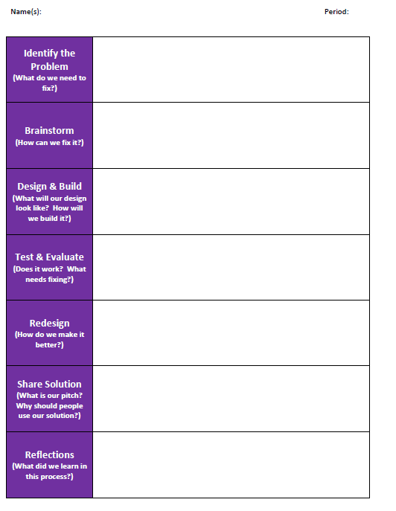

Slide 17
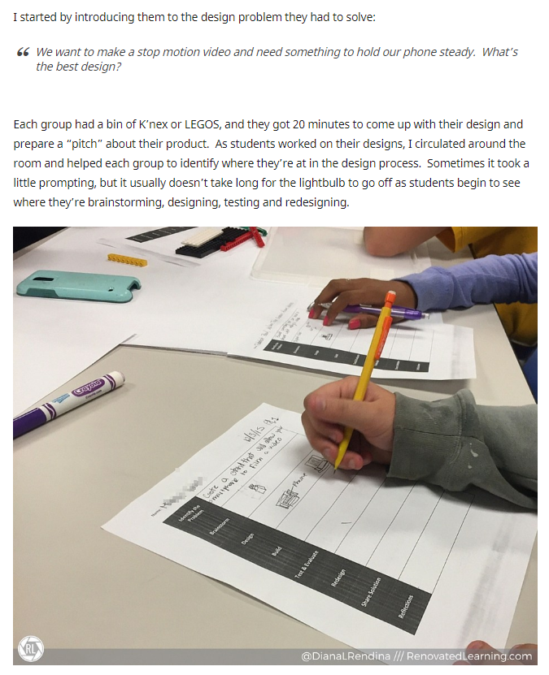
Introduce Design Problem to be solved…...

Slide 18
What Makes a Good Project?
The work is:
Substantial
Shareable
Personally Meaningful
*May take a class period or a whole term to complete

Slide 19
Elements of a Good Project
Purpose and Relevance
Is the project meaningful. Does it prompt intrigue, effort, and creativity?
Time
Is there sufficient time to provide for the alloted project?
Complexity
Does the project combine multiple subject areas? Does it call upon previous knowledge?
Connection
Are the students connected to powerful ideas, experts, or the web? Is there collaboration?
Access
Are there opportunities for students to utilize a wide variety of materials and choices?
Shareability
Are the students able to share with an authentic audience? This provides motivation, relevance, and perspective.

Slide 20
Project Based Curriculum & Ideas
Engineering by Design - (Pilot)
https://www.iteea.org/STEMCenter.aspx
Defined STEM - (Pilot)
https://www.definedstem.com/
Google Maker Camp - https://makercamp.com/
Wabisabi Learning -
https://wabisabilearning.com/
https://drive.google.com/file/d/1hm4gePNXwyOT6P2TRLucGw9nYEgFt6hD/view?usp=sharing
Project Lead the Way - https://www.pltw.org/

Slide 21
Place your screenshot here
……...
ART & LIBRARY

Slide 22
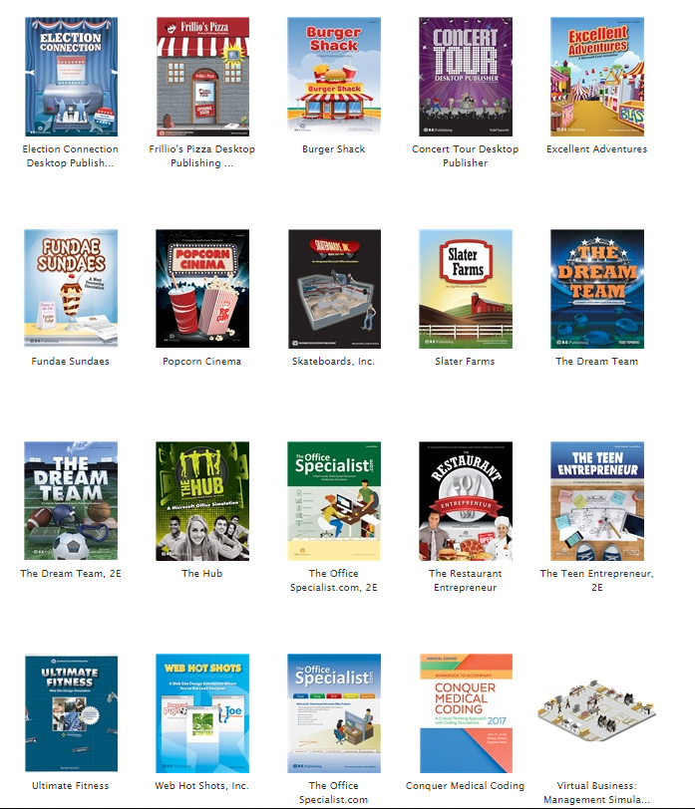
Simulations

Slide 23
Popular Makerspace Items
Dash and Dot curricula: https://education.makewonder.com/curriculum
Makey-Makey lesson plans: https://makeymakey.com/pages/educators#resources
Bee Bot activity Cards: http://www.ccc-computing.org.uk/misc/download/zyr5Y9Cgt9e7C9fE
Ozobot lesson plans: https://ozobot.com/stem-education/stem-lessons
Hummingbird Kit Tutorials: https://www.hummingbirdkit.com/learning/tutorials
Snap Circuits https://stem.neu.edu/programs/ayp/fieldtrips/activities/snapcircuits/

Slide 24
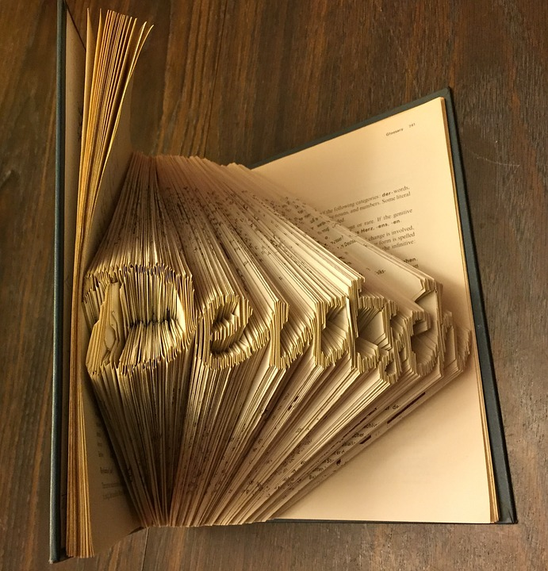
Keep in Mind……...
Use what you know!
Does the Student know why?
Improve!
Improve!
Improve!

Slide 25
When you have exhausted all possibilities, remember this: you haven’t - Thomas Edison

Slide 26
BOCES ISS Makerspace
A place for all.
Our makerspace will be a regional space for all districts to come learn and create.
Items:
Virtual reality
Augmented reality
Coding
Robotics
Sewing
Soldering
Circuitry
Drones
And much much more!
Unique to our Space:
Glowforge laser cutter
Large number of 3D printers
360 cameras
VR headsets
Full collection of little bits
Large scale
We will have many resources available in our makerspace that districts may not have readily available.
Watch for Upcoming Trainings:
VR/AR Regional Training
Green Screen Regional Training
Drone Zone Regional Offering
How to Videos for Your Makerspace
Cricut Regional Training
Glowforge Regional Training

Slide 27
You can find me at:
rlawrence@cayboces.org
ccahill@cayboces.org
Any questions?

Slide 28
Credits
Special thanks for the free resources:
Presentation template by SlidesCarnival
Photographs by Unsplash
Backgrounds by Pixeden

Slide 29
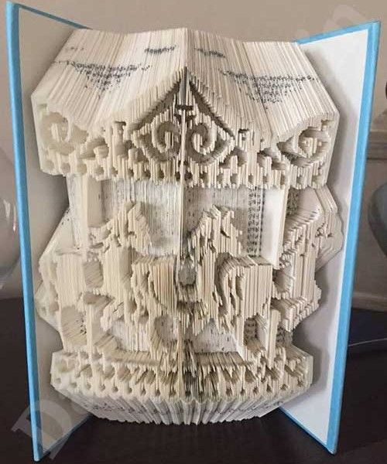
BACK

Slide 30
Works Cited
Martinez, S. L., & Stager, G. (2013). Invent to learn: Making, tinkering, and engineering in the classroom.
Polya, George. (1945). How to Solve It: ANew Aspect of Mathematical Method Princeton, NJ: Princeton University Press.
Resnick, Mitchel. (2007). All I Really Need to Know (About Creative Thinking) I Learned (By Studying How Children Learn) in Kindergarten. Paper Presented at the Proceedings of the 6th ACM SIGCHI conference on Creativity & cognition.

