Slide 1
District Parent Council
Google Classroom
Classlink
Tom Bunn – Director of Technology
Notes:
Hello my name is Tom Bunn, Director of Technology for the school district.
Tonight, my goal is to share with you two technology resources we using, Google Classroom and Classlink
Google Classroom is the District’s learning management system where all student resources and work is stored, and Classlink is a one-stop-shop for students to quickly and easily gain access to their classroom applications and resources
I would to show you the overview of Classroom and its features, but also cover the settings as well. Modifying some settings can help you better navigate and use the tool. I will also go over some frequently asked questions our department have received from parents.
I will then discuss Classlink and leave some time for any questions

Slide 2
Google Classroom
How teachers use Google Classroom
Assign classwork
Share relevant classroom materials
Integrate with other applications
Make announcements
Collaborate with students
* Google Classroom is web based and students must have internet connectivity to access
* Can be accessed from any device once a student has logged in with their Google credentials
Notes:
Google Classroom is an online platform that helps students and teachers organize work, boost collaboration, and foster communication.
The platform is completely web based and accessible from any device once a student has logged in with their District Google Credentials
What will you find in Google Classroom – Classroom materials such as syllabus or weekly schedule, articles, and classroom rules for both hybrid and remote learning
Teachers are integrating other applications into Classroom and making content available all in one area making it easy to access for students
Collaboration is occurring in classroom real-time with the use of Drive, Docs, and Sheets where content can be shared, updated, and real-time feedback can be given

Slide 3
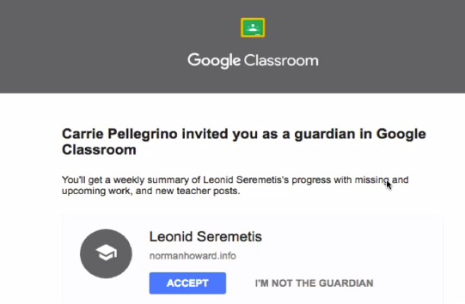
Parent/Guardian Access to Google Classroom
Parents do not sign in to Google Classroom (Only Students - School Accounts)
Parents receive information through the email provided to the school
Guardian Summary
Progress Reports - Teacher must enter parent email for student, parent must accept invitation
Receive Daily or Weekly (Friday) Summary
Includes Missing Work, Upcoming Work and Class Activites
Teacher Name
Student name
Parent Information
Notes:
As a Parent/Guardian you can receive email summaries about your student’s activity in Classroom.
NO need to sign up for a Google Classroom – Teachers will send out a invite to your personal email the District has on file – You have 120 days to accept your invitation – If you didn’t receive a invitation, please reach out to the student’s teacher
You can choose to receive daily or weekly summaries
Summaries include:
Missing work—Work that’s late at the time the email was sent
Upcoming work—Work that’s due today and tomorrow (for daily emails) or work that’s due in the upcoming week (for weekly emails)
Class activity—Announcements, assignments, and questions recently posted by teachers

Slide 4
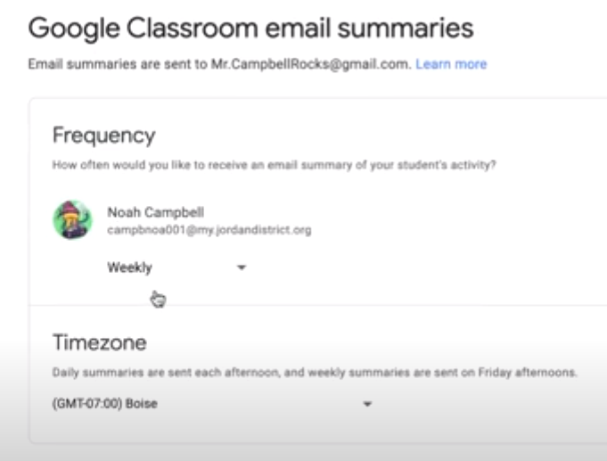
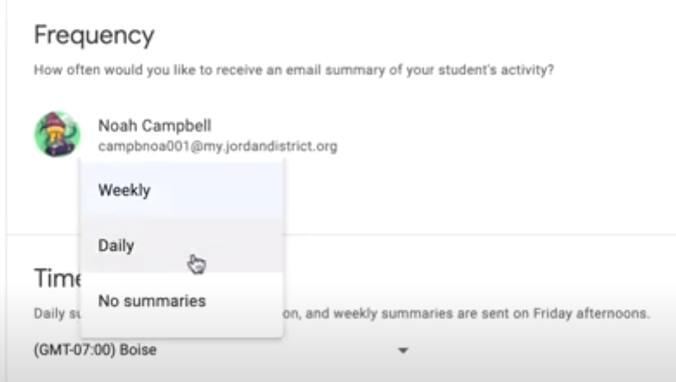
Classroom Email Summaries (Parents/Guardians)
Once you have accepted an invite to recieve summaries, you can change your summary settings with a Google Account.
To view or update your email summary settings:
Open any email summary that has been sent to you or go to classroom.google.com\gs
Go to the bottom of the email and click settings
Under Frequency, click the down arrow and make a selection
Parent Name
Student Name
Student Name
Notes:
Once you have accepted your invitation, you can change your Summary settings and update your Frequency on how often you receive communications if you feel it’s necessary.
Show them where to navigate to make that change
Navigate to classroom.google.com/gs
Click Settings
Under frequency click the down arrow to make your selection

Slide 5
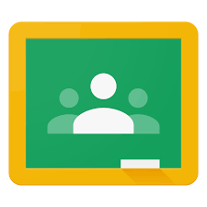
Logging In (Student)
*No personal accounts
Computer:
Classroom.google.com
“Sign in” firstlast@aecsd.education
Click on the grid and select Google Classroom
Classes will be there to join or access
Chromebook:
Log in to the Chromebook
Click the circle on the bottom left
Click the up arrow in the center to display apps
Select Google Classroom
Or, type “Classroom” in search bar and select
Notes:
Logging into Google Classroom is a little different if you are using a Personal Device or a District Issued Device
Personal Device
Open Google Chrome and navigate to classroom.google.com
Click the Sign in Button – login your student with the following – firstnamelastname@aecsd.education
Click on the Grid in the upper right hand corner and select Google Classroom the options
Classes will be listed to Join or Access
District Issued Chromebook
Log into the Chromebook
Click the circle in the bottom left corner
Click the up arrow in the center to display apps
Select Google Classroom

Slide 6
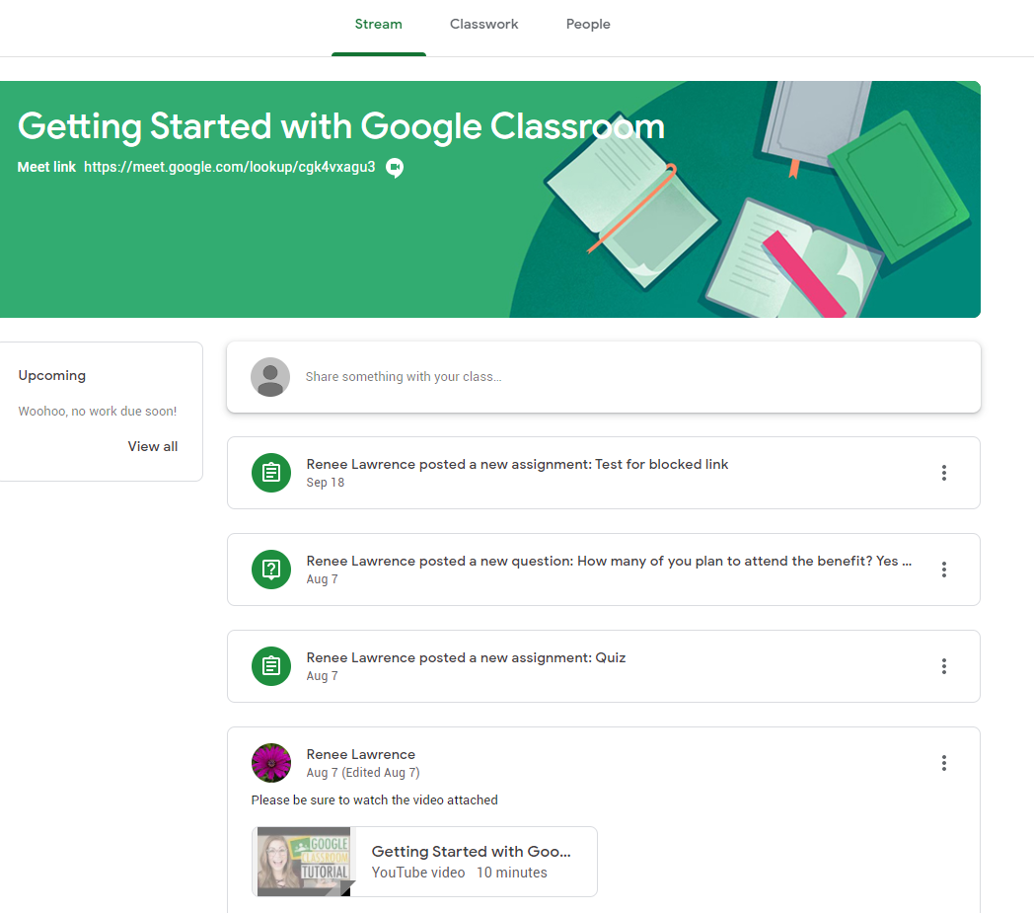
Student - Google Classroom - Stream
Announcements
Updates/Reminders
Class Posts & Discussions
Assignments are not in this section
Notes:
The Stream is the social hub of Google Classroom (think something like Facebook). This is where announcements can be made by the teacher. Students are able to share resources or ask questions. Any assignments created on the Classwork tab are announced on the Stream.
Show the feed

Slide 7
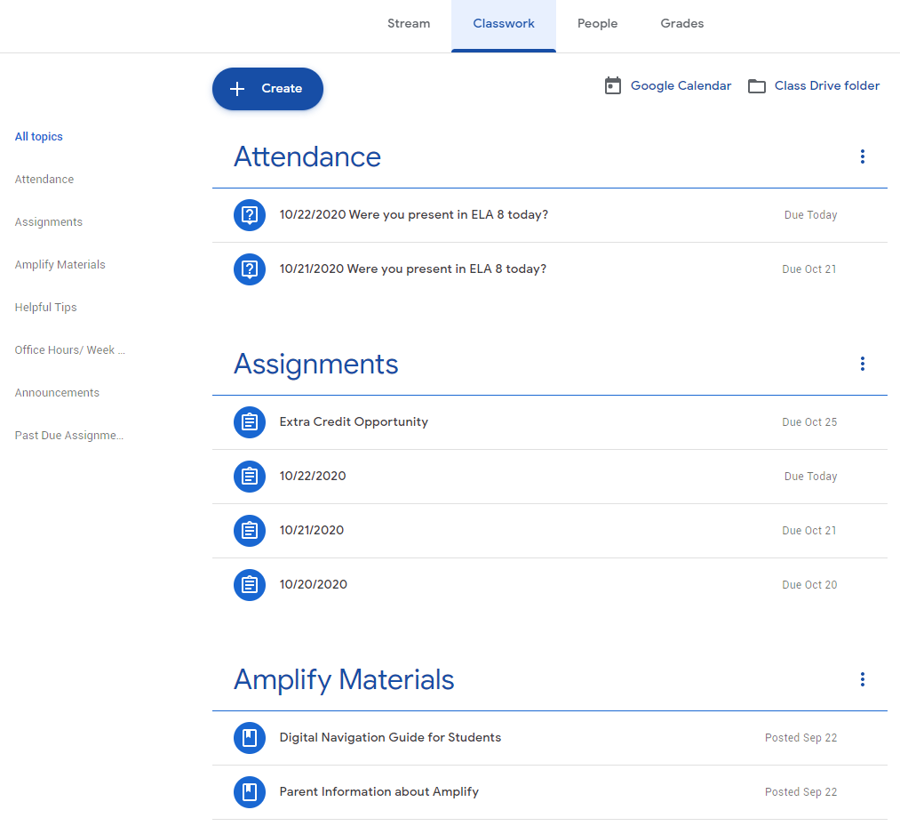
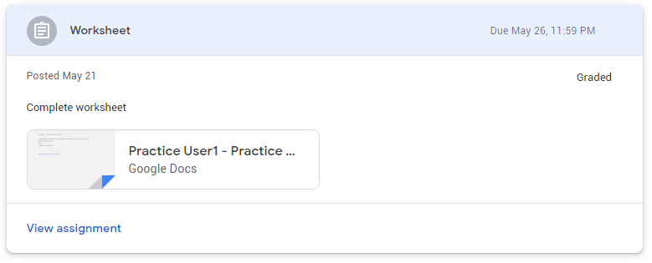
Student - Google Classroom - Classwork
May or may not be organized by topics
Consists of Assignments, Quizzes, Questions, and Material
View details of assignments by clicking on the assignment – full details can be viewed by clicking “View Assignment”
Notes:
The student’s classwork tab is their primary workspace. Here they will access their assignments and quizzes, post/respond to questions and access course materials.
They can view the details of assignments by clicking on a individual assignment and clicking “View assignment”
Show Classwork

Slide 8
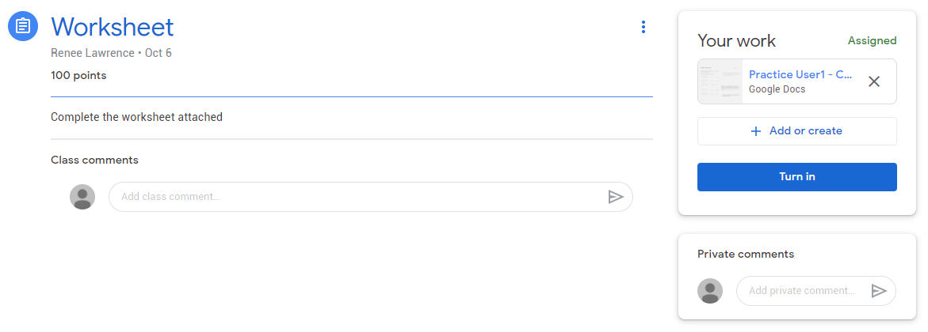
Student - Google Classroom – Turning in Work
Completed assignments can be handed in by clicking the “Turn In” button in the top right.
If they need to make revisions, they can click the “Unsubmit” button to turn in again.
Notes:
Students can turn in assignments simply by clicking the “Turn In” button in the top right corner of the screen.
One common mistake we see is students accidently submit an assignment with no work attached. If they need to resubmit the assignment they can simply click the Un-submit button on the right hand side of the page and then click the turn in button again once the work is attached and/or corrected.

Slide 9
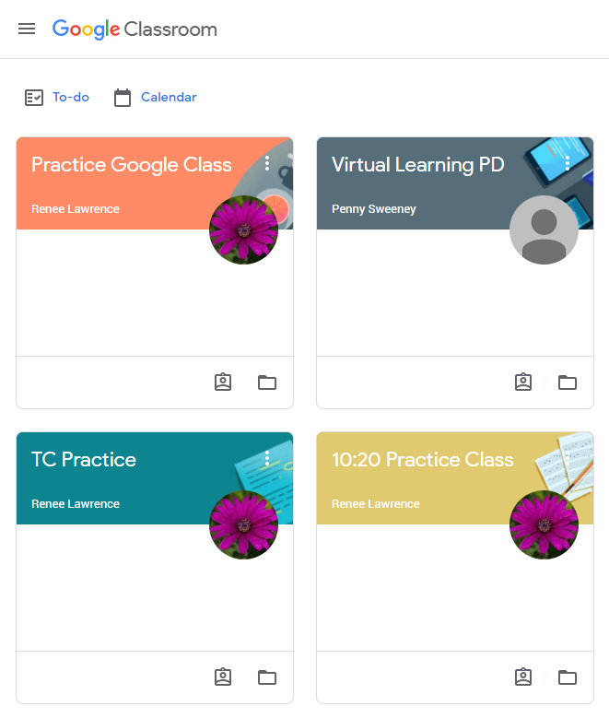
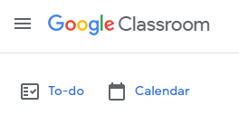
Helping Students
Guardian summaries do not allow access to assignments. To help, you must have the student log in and review work through Google Classroom together.
The “To-do” page shown on the top left when you first log in to Google Classroom will show all actual assignments that are due, missing, and completed.
Clicking on “Calendar” will provide a view of assignments on designated dates.
Notes:
The Guardian Summaries you will receive in email are only text summaries of what the student has completed. In order to help your student, you must have the student login and work through Classroom together.
Please note, you can get a quick glance at the outstanding work the student needs to complete by clicking the To-Do page in the top left corner. That will show all assignments for all classes that are due, missing and completed.
Clicking on the Calendar icon will provide a view of all assignments as well as their due dates

Slide 10
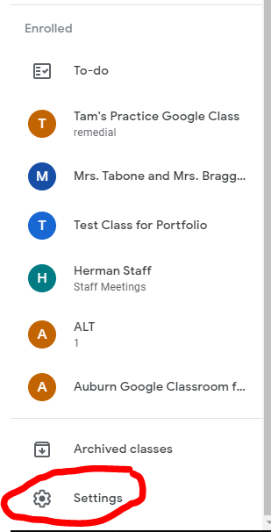
Limiting Google Classroom Notifications
In Google Classroom, click Settings in the bottom left hand corner of the screen to access Classroom Notifications.
It’s recommended to turn off all email notifications, with the exception of
Private comments on work
Returned work and grades from your teachers
Due-date reminders for your work
Notes:
One of the major questions/frustrations we receive is the notifications that are generated from Classroom. These notifications tend to clutter a student’s inbox which can lead to important messages being missed. It is recommended that students disable all classroom notifications with the exception of
Private comments on work
Returned work and grades from your teachers
Due-date reminders for your work
That will ensure all important communication from teachers is received and you won’t miss any important upcoming assignments

Slide 11
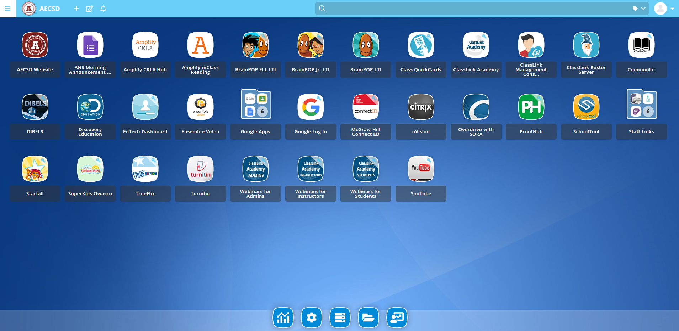
Classlink
Provides a district safe and secure Single Sign-On (SSO)
Allows for centralized access to digital applications from any device
Provides access to all files, including files that are not located in Google Drive
Provides Analytics - a summary of connected logins, users, and apps
Notes:
Classlink is a piece of software we are rolling out to help both educators and students eliminate the time wasted on login issues. Classlink provides a secure single sign on process for students to the entire K-12 library of applications, links and other school resources from one location and on any device.
Students will have access to any/all files saved on the school network, either on a Windows based computer or in the Cloud via Google Drive
We are implementing District wide but have a specific focus on our K-2 students first, in order to streamline their access as quickly as possible.
We have Technology Mentors at every building working very hard training both Staff and Students on the new platform.

Slide 12
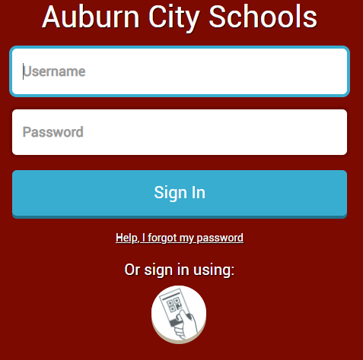
Classlink Tools for Schools
Analytics – Shows the district the complete usage picture of digital learning tools – real time and historical usage of most used apps by building, grade, classroom and individual
Management – Allows district to manage environment and provide students with apps that apply to them
Rostering- Safely share student rosters to the digital learning resources applicable to the students
Attendance – Through login and analytics, student attendance can be tracked and monitored
Notes:
Additional benefits of Classlink
The District can get a big picture in terms of our digital learning tool usage in real-time
We can easily manage and deploy applications to students in the hybrid or remote model effortlessly
We now are automating our student rostering, which eliminates the time spent on manually moving students as they may move teachers, buildings, etc..
We will also be able to better track our remote student attendance through this console. When a student logs in through Classlink we can now generate reports provide this to our Building Principals in real-time

Slide 13
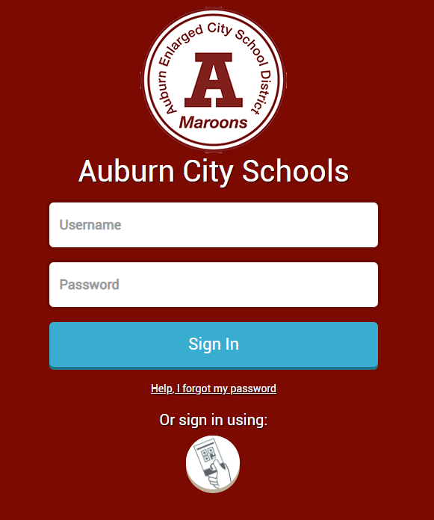
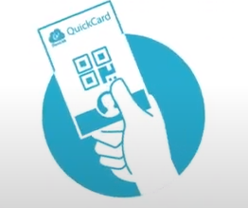
Classlink - Logging In
Quick Cards
QuickCards are printed and provided to students
Turn on Chromebook
Select “Sign in with QuickCard”
Hold QuickCard in front of screen to log in
Go to aecsd.education
Click on School and select a school
Scroll down and select Student Resources on the left
Select CLASSLINK –Launchpad
Sign in with QuickCard
Logging in on Chromebook
Turn on the Chromebook
Select option to “Sign in”
Sign in with Username and Password
Go to aecsd.education
Click on School and select a school
Scroll down and select Student Resources on the left
Select CLASSLINK –Launchpad
Sign in with Username and Password
Notes:
Students can access classlink from any device or any browser
If they navigate to aecsd.education click on their School then click Student Resources, they can select Classlink – LaunchPad
They can sign in with their either their student username/password OR they can sign on with a QuickCard
QuickCards are unique student identifiers in a similar format to a QR code that are used to login students into Classlink without using a username or password.
All Elementary students will be using QuickCards to sign in. QuickCards will be either mailed home to remote students or provided to hybrid students when they are onsite.

Slide 14
Classlink Tools for Students
Students log in to see all of their apps in one location. Along with the single sign in benefit, students also have access to the features listed below.
My Backpack - Launch and sign in to all applications in one location
My Files - Real time access to all files on the school network, as well as files on Google Drive
My Analytics - Provides students with detailed information about usage such as login history, usage charts, and top apps
Notes:
Classlink Tools for Students
My Backpack App – Students have access to all course materials broken down by class as they are listed in SchoolTool. This allows students to access and launch all specific applications in one location.
My Files – Students can access both their District Network files as well as all Google Drive files from this location making it a convenient one stop shop for them
My Analytics – Provides students with detailed information about their own usage such as login history and application usage.

Slide 15
Technical Support
For any support related to District issued devices or access with any software applications including Google Classroom, please email ihelp@aecsd.education
Parent Technology Resources
Visit http://aecsd.education and under Departments, click Technology, then Parent Technology Resources
Notes:
Feel free to contact our IT department with any issues relating to technology. Additionally, if you would like to learn more about the various Google resources we have available, you can do so by going to our district website, Click Technology under Departments, and click the Parent Technology Resources. This page contains a ton of useful resources to get you up to speed.

Slide 16
Family Engagement Nights
Casey Park Elementary November 12th @ 5:30pm
Genesee Elementary November 10th @ 5:30pm
Herman Elementary November 9th @ 6pm
Owasco Elementary November 4th @ 6pm
Seward Elementary November 10th @ 6:30pm
Notes:
Additionally, we are hosting upcoming Family Engagement Night’s which will have a specific focus on Technology. Topics will include Google Classroom, Classlink, and any other specific technology related questions you may have. These meetings will take place over Zoom and will be posted to each buildings webpage for later consumption. Meeting invites will be sent out by each building Principal a couple of days prior to each meeting.

Slide 17
Questions?

